Slide 1
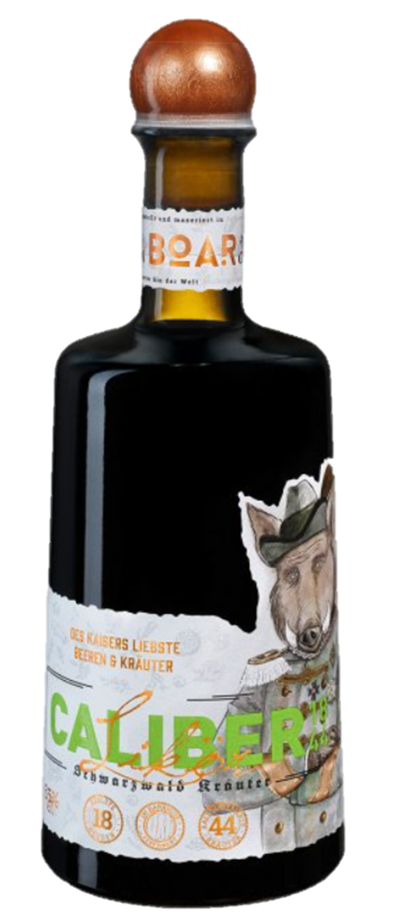
CALIBER
18
44
18
44
Caliber 1844® is a very popular herbal liqueur from the Black Forest (Schwarzwald). Its´ special character comes from 18 aromatic berries and 44 fine herbs from its´ homeland. Cold macerated and aged in oak barrels for three months, this Black Forest liqueur matures to a very special format – of genuine caliber.
For the 175th anniversary - as the name implies, is the year of foundation on 1844. Caliber was newly composed with a large selection of berries and herbs. These include: Blackcurrants, gooseberries, cranberries, mulberries, raspberries but also selected herbs such as arnica, valerian, basil, wild garlic and savory. Mineralized by the special Peterstal spring water from our own spring, refined and produced with BOAR Gin, the world’s most awarded gin.
Type | Producer | Alcohol content, ABV | Packing | EAN
Herbal liqueur | BOAR distillery GbR, Germany | 35% | 500ml, class bottle, plastic cap | 0617957694994

Slide 2
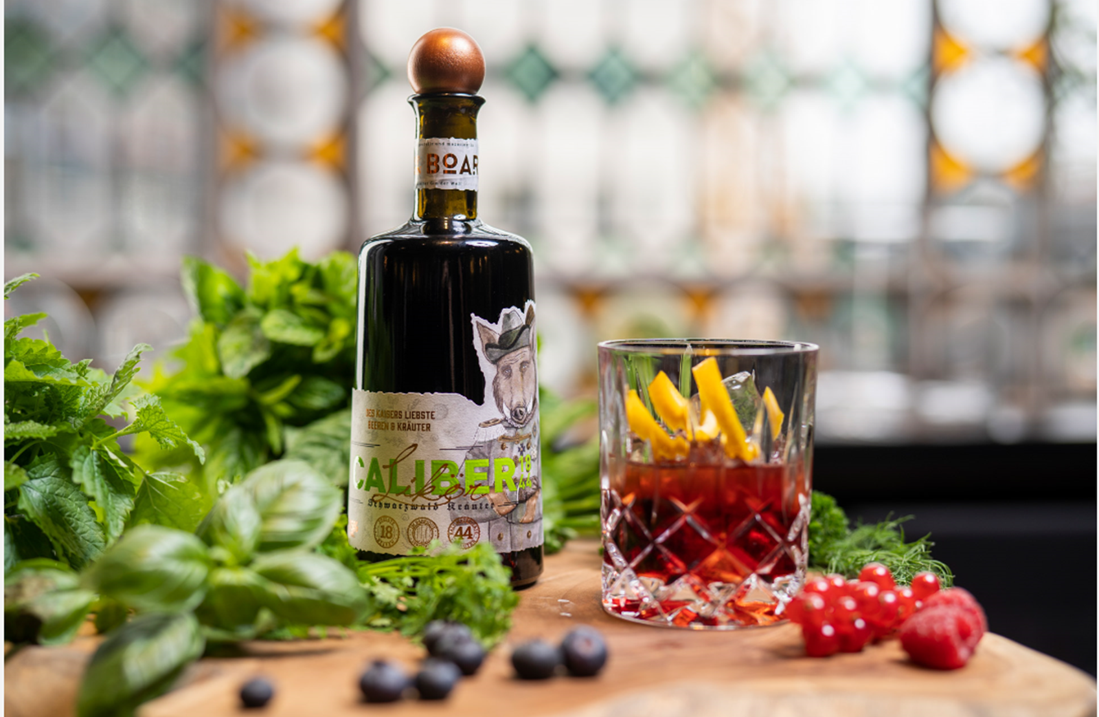
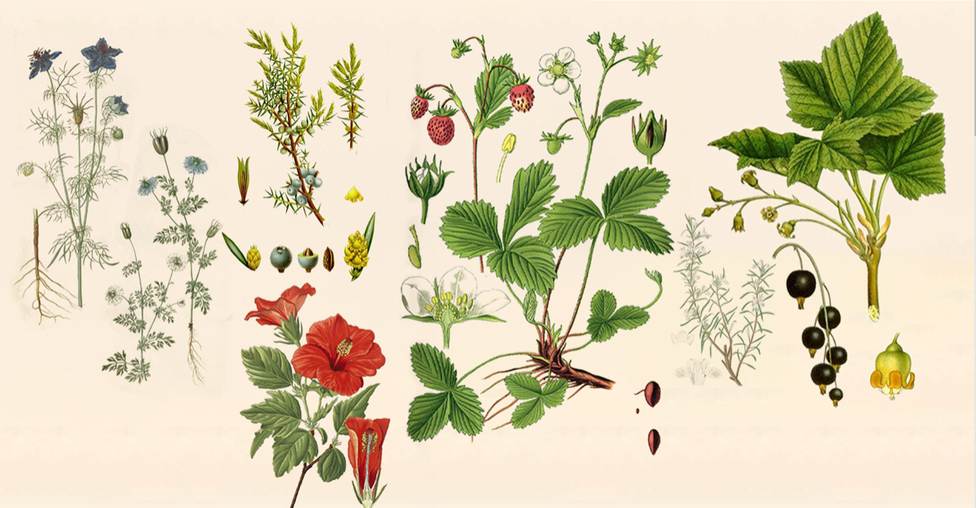



CALIBER
18
44
Orders & Inquiries:
Ginland – Primalex Capital OÜ
Web: ginland.eu
info.ginland@gmail.com
Sami Loppi +358 40 555 3001
www.facebook/Ginland
ginland.eu is registered trademark of Primalex Capital OÜ, Liivalaia 33, Tallinn 10118, Estonia

